Slide 1
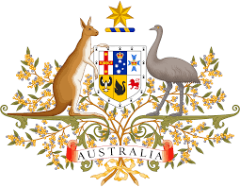
The Australian Constitution
Yr 7 Civics and Citizenship

Slide 2
Lesson Aims:
Review the topic of Federation
To understand what the purpose of Australia’s Constitution is
To understand the value of the Australian Constitution
Key vocab:
-Federation
-Constitution

Slide 3
Federation in Australia
A federation is the joining of the colonies to become one nation.
Colonies In 1860 there were six British colonies in Australia.
The main laws of the colonies were made by the British Parliament.
Write this in your book!

Slide 4
Federation – Behind the News
https://www.youtube.com/watch?v=ecB-Lpm_AZ0
Australia's Federation - Behind the News - YouTube
Play the video twice. Students listen the first time.
Students fill out their worksheets whilst the video is playing the second time. Teacher can pause in between questions to discuss the answers.

Slide 5
Discuss the BtN Federation story with another student and record the main points of your discussion.
Before Federation, Australia was divided into six separate ______________. | Which other country might have been part of Australia?
Who was Henry Parkes? | What was his famous speech about?
Why were initial attempts to become a Federation rejected? | What role did Alfred Deakin play in Australia becoming a Federation?
In what year did Australia become a nation? | Who was Australia’s first Prime Minister?
How did Federation impact on Indigenous people and Chinese migrants?

Slide 6
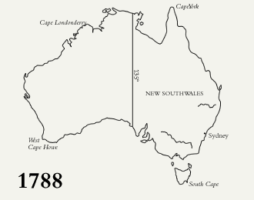

Slide 7
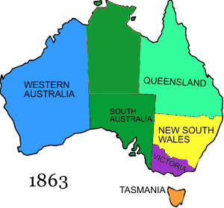

Slide 8
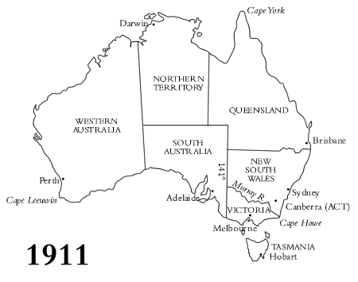

Slide 9

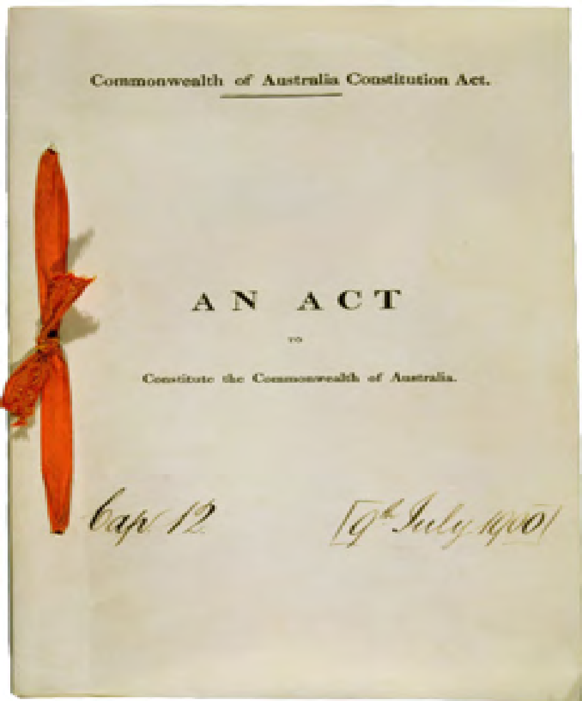
The Australian Constitution- History
The Australian Constitution is the set of rules by which Australia is run.
It came into effect on 1 January 1901 (Federation), establishing the Commonwealth of Australia.
Before this, Australia was not a nation and each of the colonies had their own separate rules/laws.
The Constitution was written to explain how the new nation would operate and what the main features of its government would be.
Write the underlined words in your book!

Slide 10
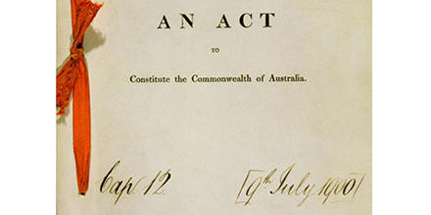


The Australian Constitution- Videos
A written document that set out the rules by which our country is governed.
https://www.abc.net.au/btn/classroom/constitution/10529046

Slide 11
Cloze Activity – write in your book and fill in the gaps as you go.
The Australian ___________________provides the________________ for how Australia is run. Described as the birth certificate of the nation, the Constitution is made up of _________chapters and ___________ sections. The Constitution united the_________ British colonies to form a ________________________. The Constitution describes the powers of ______________ and__________________ parliaments. Sections _________and_________ outline the law-making powers of_____________________ Parliament.
Constitution eight six nation 128 rules state commonwealth 51 52 federal

